Slide 1
Introduction to Cloud Computing
Cloud Computing: A Hands-On Approach by Arshdeep Bahga and Vijay Madisetti
Cloud Computing for Science and Engineering by Kan Foster and Dennis Gannon
www.cloudcomputingbook.info
https://cloud4scieng.org/

Slide 2
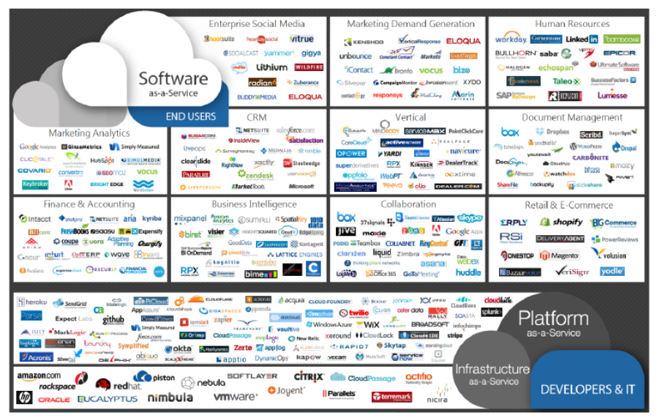
Source: Cloud Computing for Science and Engineering by Kan Foster and Dennis Gannon
Notes:
I think everyone knows that cloud computing is a really hot topic. Today, thousands of companies oﬀer services with some or all of these characteristics, from low-level computing and storage to sophisticated software.

Slide 3
Outline
Cloud Computing definition
Characteristics of cloud computing
Cloud deployment models
Cloud service models
http://www.numericana.com/answer/graphs.htm
Notes:
In this chapter, we will learn the basic concept and knowledge about cloud computing.

Slide 4
Definition of Cloud Computing
The U.S. National Institute of Standards and Technology (NIST) defines cloud computing as:
Cloud computing is a model for enabling ubiquitous, convenient, on-demand network access to a shared pool of configurable computing resources (e.g., networks, servers, storage, applications, and services) that can be rapidly provisioned and released with minimal management effort or service provider interaction.
Notes:
Cloud computing is a transformative computing paradigm and involves delivering applications and services over the internet. Cloud computing provide computing, networking and storage resources on demand with a “pay as you go” cost model.

Slide 5
Characteristics of Cloud Computing
On-demand self service:
Cloud computing resources can be provisioned on-demand by the users, without requiring interactions with the cloud service provider. The process of provisioning resources is automated.
Broad network access:
Cloud computing resources can be accessed over the network using standard access mechanisms that provide platform-independent access through the use of heterogeneous client platforms such as workstations, laptops, tablets and smartphones.
Notes:
The cloud landscape is large, diverse, and complex. The U.S. National Institute of Standards and Technology lists ﬁve essential characteristics of cloud computing : on-demand self-service, broad network access, resource pooling, rapid elasticity or expansion, and measured service

Slide 6
Characteristics of Cloud Computing
Resource pooling:
The computing and storage resources provided by cloud service providers are pooled to serve multiple users using multi-tenancy. Multi-tenant aspects of the cloud allow multiple users to be served by the same physical hardware.
Rapid elasticity:
Cloud computing resources can be provisioned rapidly and elastically. Cloud resources can be rapidly scaled up or down based on demand.

Slide 7
Characteristics of Cloud Computing
Measured service:
Cloud computing resources are provided to users on a pay-per-use model. The usage of the cloud resources is measured and the user is charged based on some specific metric.
Performance:
Cloud computing provides improved performance for applications since the resources available to the applications can be scaled up or down based on the dynamic application workloads.

Slide 8
Characteristics of Cloud Computing
Reduced costs:
Cloud computing provides cost benefits for applications as only as much computing and storage resources as required can be provisioned dynamically, and upfront investment in purchase of computing assets to cover worst case requirements is avoid.
Outsourced Management:
Cloud computing allows the users (individuals, large organizations, small and medium enterprises and governments) to outsource the IT infrastructure requirements to external cloud providers.

Slide 9
Characteristics of Cloud Computing
Reliability:
Applications deployed in cloud computing environments generally have a higher reliability since the underlying IT infrastructure is professionally managed by the cloud service.
Multi-tenancy:
• The multi-tenanted approach of the cloud allows multiple users to make use of the same shared resources.
• In virtual multi-tenancy, computing and storage resources are shared among multiple users.
• In organic multi-tenancy every component in the system architecture is shared among multiple tenants

Slide 10
Cloud Service Models
Software as a Service (SaaS)
Applications, management and user interfaces provided over a network
Platform as a Service (PaaS)
Application development frameworks, operating systems and deployment frameworks
Infrastructure as a Service (IaaS)
Virtual computing, storage and network resource that can be provisioned on demand

Slide 11
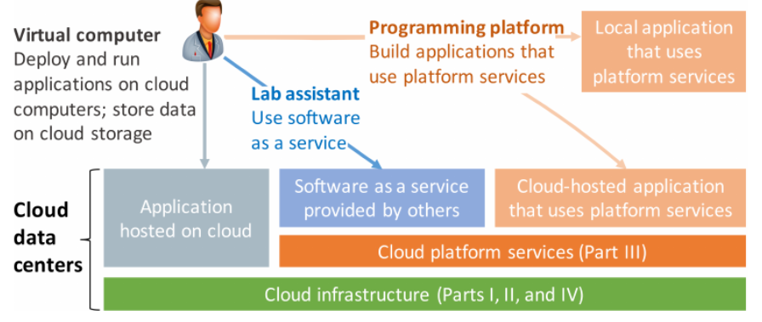
Clouds can be used in three distinct ways: IaaS - As a source of on-demand computing and storage on which to run their own software (left); SaaS - as a source of software that can be run over the network (center) PaaS - as a source of new platform capabilities that can allow development of new types of software (right).
Source: Cloud Computing for Science and Engineering by Kan Foster and Dennis Gannon
Notes:
Inevitably, the boundaries between these diﬀerent types of cloud system and cloud usage are not always crisply deﬁned. For example, a growing number of software-as-a-service oﬀerings provide APIs that allow them to be used as platform services, and we often see platform services enhancing the value of virtual computer oﬀerings.

Slide 12
Software-as-a-Service (SaaS)
Software/Interface
SaaS provides the users a complete software application or the user interface to the application itself.
Outsourced Management
The cloud service provider manages the underlying cloud infrastructure including servers, network, operating systems, storage and application software, and the user is unaware of the underlying architecture of the cloud.
Thin client interfaces
Applications are provided to the user through a thin client interface (e.g., a browser). SaaS applications are platform independent and can be accessed from various client devices such as workstations, laptop, tablets and smartphones, running different operating systems.
Ubiquitous Access
Since the cloud service provider manages both the application and data, the users are able to access the applications from anywhere.
Notes:
software as a service (SaaS): A cloud is a source of powerful software that can perform certain tasks more eﬀectively and/or cheaply than you can yourself: for example, Academia.edu, Google Scholar, and ResearchGate to access information about publications, facilitating research and citation; GitHub to manage software and documents, facilitating collaboration, software sharing, and reproducibility; Google Docs, Box, and Dropbox to share data; Science Exchange to order experiments; Figshare for publishing data; Globus to move and manage large data; Skype and other services for communication; and m any others. In each case, you can avoid substantial cognitive, administrative, and ﬁnancial burdens that you or members of your laboratory would incur if they had to perform these tasks themselves.

Slide 13
SaaS
Benefit
Lower costs
No infrastructure required
Seamless upgrades
Guaranteed performance
Automated backups
Easy data recovery
Secure
High adoption
On-the move access
Notes:
.

Slide 14
SaaS
Characteristics
Multi-tenancy
On-demand software
Open integration protocols
Social network integration
Notes:
.

Slide 15
SaaS
Adoption
Individual users: High
Small & medium enterprises: High
Large organizations: High
Government: Medium
Notes:
.

Slide 16
SaaS
Examples
Google Apps
Salesforce.com
Facebook
Zoho
Dropbox
Taleo
Microsoft Office 365
Linkedin
Slideshare
CareCloud
Notes:
.

Slide 17
Platform-as-a-Service (PaaS)
Development & Deployment:
PaaS provides the users the capability to develop and deploy application in the cloud using the development tools, application programming interfaces (APIs), software libraries and services provided by the cloud service provider.
Provider Manages Infrastructure:
The cloud service provider manages the underlying cloud infrastructure including servers, network, operating systems and storage.
User Manages Application:
The users, themselves, are responsible for developing, deploying, configuring and managing applications on the cloud infrastructure.
Notes:
platform as a service (PaaS) A cloud is a programming platform: that is, a collection of powerful software mechanisms that you can use to build software with capabilities that would be diﬃcult or expensive to duplicate in your own lab : for example, an event processing system that can process millions of events per second, a database that can scale to billions of rows, an identity management service that can handle dozens of diﬀerent identity providers, a data transfer service that can move terabytes securely and reliably, or a service that is replicated in multiple geographic regions to ensure continuous operations. These platform capabilities are arguably the most exciting part of cloud computing, because they enable individual programmers to create and operate software systems that would otherwise require large teams. They allow the cloud to be used as an interactive environment for large-scale computational experimentation and discovery. They can al so be the most challenging to use eﬀectively, because they have often been developed for use cases rather diﬀerent from traditional technical computing. In addition, it is in this area that we see the biggest variation across cloud vendors in terms of capabilities and interfaces.

Slide 18
PaaS
Benefit
Lower upfront & operations costs
No IT infrastructure management costs
Improved scalability
Higher performance
Secured access
Quick & easy development
Seamless integration
Notes:
.

Slide 19
PaaS
Characteristics
Multi-tenancy
Open integration protocols
App development tools & SDKs
Analytics
Notes:
.

Slide 20
PaaS
Adoption
Individual users: Low
Small & medium enterprises: Medium
Large organizations: High
Government: Medium
Notes:
.

Slide 21
PaaS
Examples
Google App Engine
Windows Azure Platform
Force.com
RightScale
Heroku
Github
Gigaspaces
AppScale
OpenStack
LongJump
Notes:
.

Slide 22
IaaS
Infrastructure-as-a-Service (IaaS)
Resource Provisioning
Provides the users the capability to provision computing and storage resources.
Virtual Machines
These resources are provided to the users as virtual machine instances and virtual storage. Users can start, stop, configure and manage the virtual machine instances and virtual storage.
Provider Managers Infrastructure:
The cloud service provider manages the underlying infrastructure.
Pay-per-use/Pay-as-you-go:
Virtual resources provisioned by the users are billed based on a pay-per-use/pay-as-you-go paradigm.
Notes:
Infrastructure as a service (IaaS) First, a cloud is an elastic computer: a source of on-demand computing and storage that you can call upon when you need computing or storage capacity larger than, or diﬀerent from, what is available locally. Accessing this capacity in the cloud may be cheaper, faster, and/or more convenient than acquiring and operating your own computing and storage systems. While there are diﬀerences between the cloud computing and storage oﬀerings from diﬀerent cloud providers, they provide quite similar capabilities: in particular, object storage and execution of virtual machines and containers.

Slide 23
IaaS
Benefit
Shift focus from IT management to core activities
No IT infrastructure management costs
Pay-per-use/pay-per-go pricing
Guaranteed performance
Dynamic scaling
Secure access
Enterprise grade infrastructure
Green IT adoption
Notes:
.

Slide 24
IaaS
Characteristics
Multi-tenancy
Virtualized hardware
Management & monitoring tools
Disaster recovery
Notes:
.

Slide 25
IaaS
Adoption
Individual users: Low
Small & medium enterprises: Medium
Large organizations: High
Government: High
Notes:
.

Slide 26
IaaS
Examples
Amazon Elastic Compute Cloud (EC2)
RackSpace
GoGrid
Eucalyptus
Joyent
Terremark
OpSource
Savvis
Nimbula
Enamoly
Notes:
.

Slide 27
Deployment Models
Public Cloud
Available for public use or a large industry group
Private Cloud
Operated for exclusive use of a single organization
Community Cloud
Available for shared use of several organizations supporting a specific community
Hybrid Cloud
Combines multiple clouds (public and private) that remain unique but bound together to offer application and data portability

Slide 28
Deployment Models
Public Cloud
Available for public use or a large industry group
Private Cloud
Operated for exclusive use of a single organization
Community Cloud
Available for shared use of several organizations supporting a specific community
Hybrid Cloud
Combines multiple clouds (public and private) that remain unique but bound together to offer application and data portability
Notes:
The cloud services operated by Amazon, Google, and Microsoft are commonly referred to as public clouds , by analogy with the public utilities (power, telephone water, sewer, etc.) on which most of us depend in our daily lives. Like public utilities, they provide computing, storage, and/or other services to any member of the public with the ability to pay. (Public clouds are not regulated like public utilities, leading some to argue that the term is inappropriate.)
In contrast, a private cloud is operated by a private institution or individual to provide computing, storage, and/or other services to a more limited audience. We can think of them as being analogous to a private electricity generator, al though the utility that they provide is not electricity but on-demand access to computing, storage, or software. Private clouds are frequently deployed in larger enterprises. IBM, VMware, and Microsoft are major providers of proprietary solutions for building on-premises cloud-like systems. The open source solutions include OpenStack, opennebula.org, hnscicloud.eu.

Slide 29
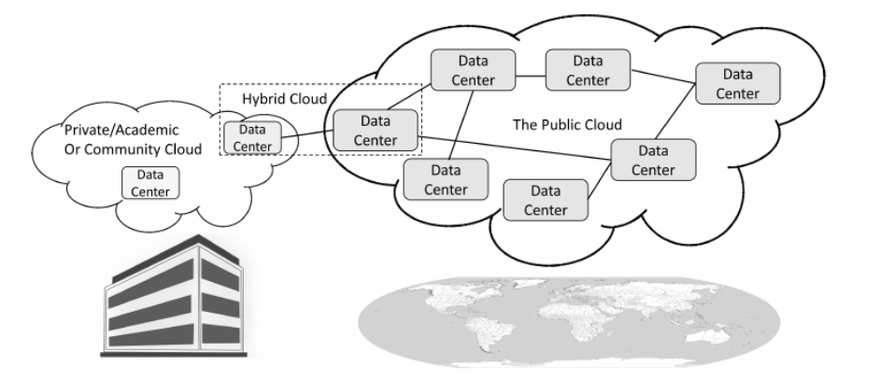
Private (including academic and community), public, and hybrid clouds.
Source: Cloud Computing for Science and Engineering by Kan Foster and Dennis Gannon
Notes:
In contrast, a private cloud is operated by a private institution or individual to provide computing, storage, and/or other services to a more limited audience. We can think of them as being analogous to a private electricity generator, al though the utility that they provide is not electricity but on-demand access to computing, storage, or software. Private clouds are frequently deployed in larger enterprises. IBM, VMware, and Microsoft are major providers of proprietary solutions for building on-premises cloud-like systems. The open source solutions include OpenStack, opennebula.org, hnscicloud.eu.

Slide 30
Public Cloud
Major cloud infrastructure providers of relevance to research
Amazon
Market leader. Computing, storage, and platform services. Extensively used in science and engineering.
Microsoft
Second biggest player. Computing, storage, and platform services with both individual and enterprise customers.
Google
Began with a service called App Engine and is now using that experience to release a full suite of cloud capabilities.
Notes:
The cloud services operated by Amazon, Google, and Microsoft are commonly referred to as public clouds , by analogy with the public utilities (power, telephone water, sewer, etc.) on which most of us depend in our daily lives. Like public utilities, they provide computing, storage, and/or other services to any member of the public with the ability to pay. (Public clouds are not regulated like public utilities, leading some to argue that the term is inappropriate.)

Slide 31
Private Cloud
OpenStack,
opennebula.org
hnscicloud.eu
Notes:
In contrast, a private cloud is operated by a private institution or individual to provide computing, storage, and/or other services to a more limited audience. We can think of them as being analogous to a private electricity generator, al though the utility that they provide is not electricity but on-demand access to computing, storage, or software. Private clouds are frequently deployed in larger enterprises. IBM, VMware, and Microsoft are major providers of proprietary solutions for building on-premises cloud-like systems.

Slide 32
Pros & Cons of Public vs Private Cloud
Public cloud pros
Massive scale
Huge and growing list of services
Highly competitive on pricing due to economies of scale
Security is strong
Freedom from managing hardware
Hardware constantly upgraded
Cons
Rules prohibit data moving to cloud
Funding models may make it hard to use
Fear of “vendor Lock-In”
Private cloud pros
May be cheaper
You can keep it off the Internet so data can be very safe.
You can optimize your own hardware
You control everything
Cons
You are responsible for everything
Not as many high level services
May not really be cheaper
You manage physical and system security

Slide 33
Pros & Cons of Public vs Private Cloud
Public cloud pros
Massive scale
Huge and growing list of services
Highly competitive on pricing due to economies of scale
Security is strong
Freedom from managing hardware
Hardware constantly upgraded
Cons
Rules prohibit data moving to cloud
Funding models may make it hard to use
Fear of “vendor Lock-In”
Private cloud pros
May be cheaper
You can keep it off the Internet so data can be very safe.
You can optimize your own hardware
You control everything
Cons
You are responsible for everything
Not as many high level services
May not really be cheaper
You manage physical and system security

